Slide 1
Safety First
Improving Workplace Safety with Hard Hat Detection
Stanley Yang, Lennard Vanderspek
Notes:
Introduce speakers

Slide 2
Objective
Hard hat detection in construction zones to improve workplace safety
Using YOLO for image detection
Roboflow Hard Hat Workers Dataset
[4] https://public.roboflow.com/object-detection/hard-hat-workers
[3] https://arxiv.org/abs/1506.02640

Slide 3
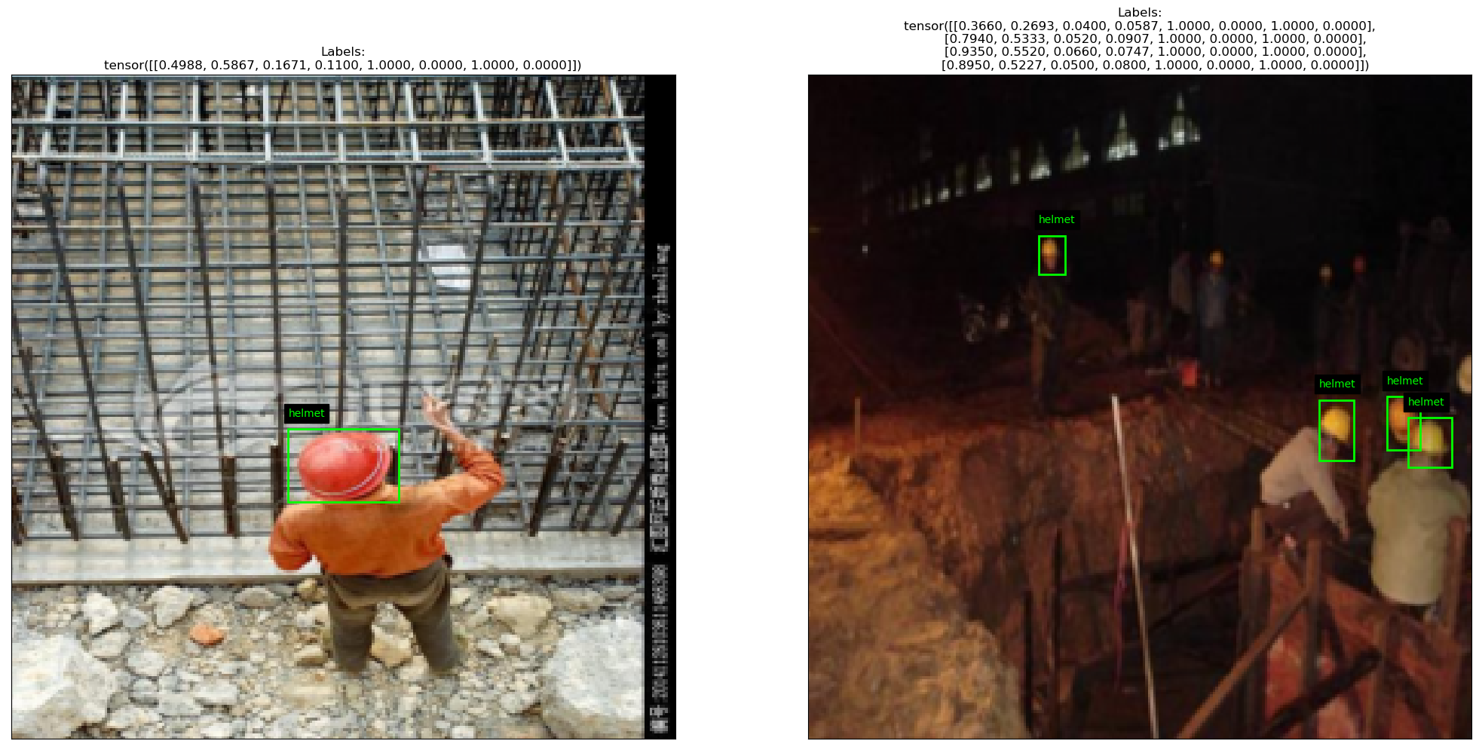
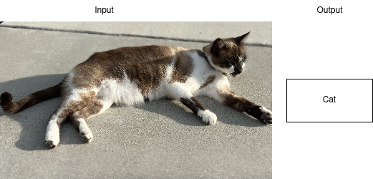
Object Classification vs Object Detection
Notes:
Object classification takes an image as input and outputs only a single predicted class label
Object detection identifies multiple objects in an image and predicts their location, size and class label

Slide 4
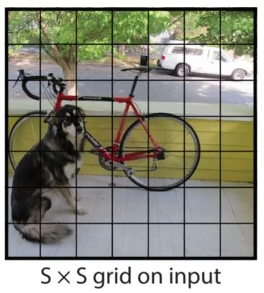
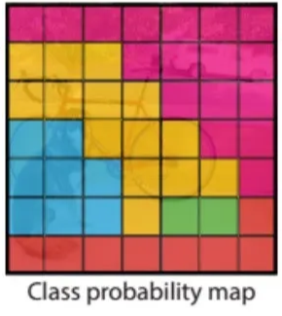
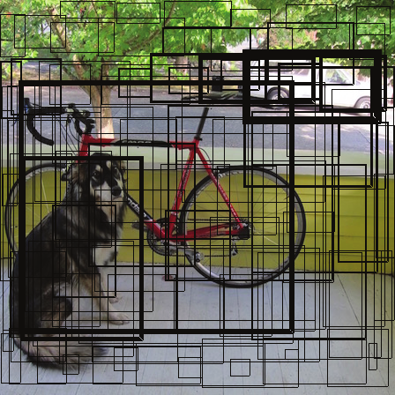
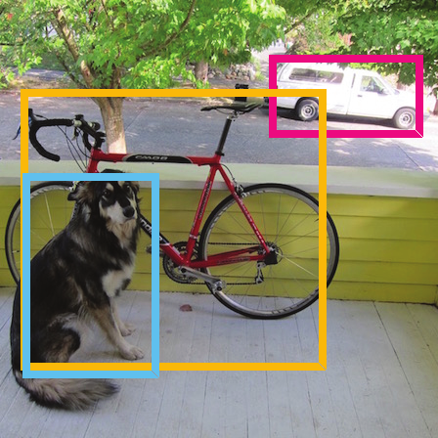
YOLO in Brief
[3] https://arxiv.org/abs/1506.02640
Notes:
YOLO works by dividing the image into a number of cells (S x S)
Each of these cells independently performs object classification and bounding box prediction
Non-max suppression is used to find the best fitting boxes for each detected object

Slide 5
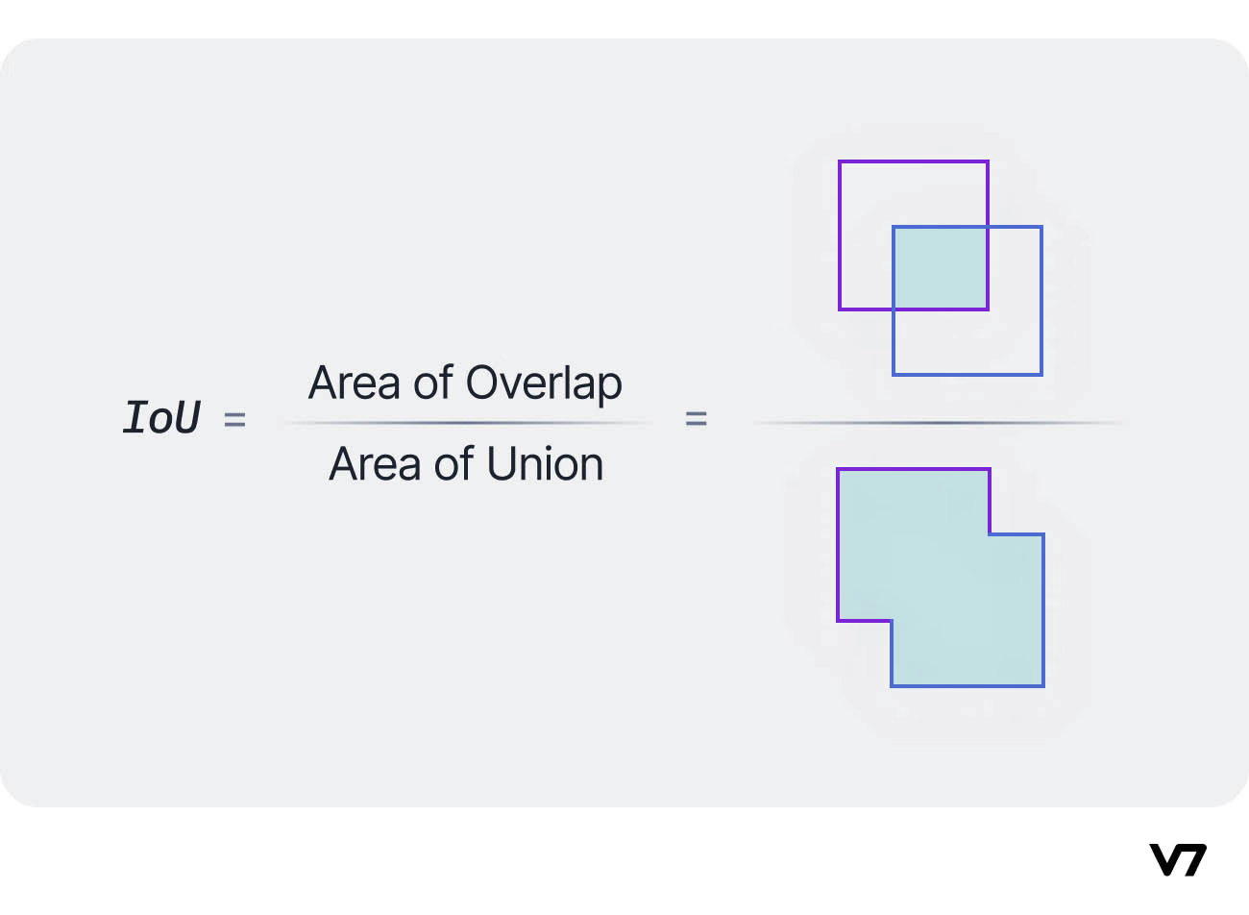
YOLO IoU
[7] https://www.v7labs.com/blog/yolo-object-detection
Notes:
Intersection of Union is used to measure confidence of each bounding box and filter out those that don’t meet the threshold

Slide 6
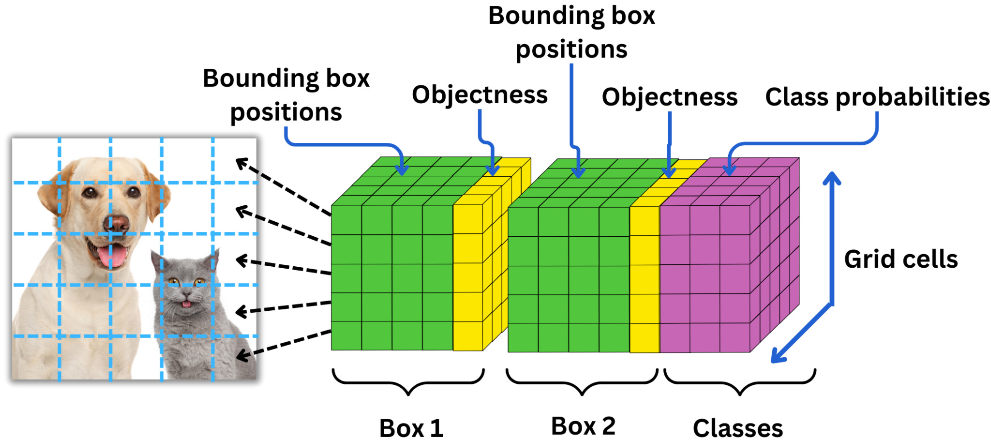
YOLO cont.
S * S * ( C + 5*B )
[9] https://newsletter.theaiedge.io/p/deep-dive-how-yolo-works-part-1-from
Notes:
Size of model is equal to SxS (number of cells) * ( C + 5*B )
C is number of classes
B is number of bounding boxes
Remember only 1 class per cell

Slide 7
YOLO vs Our Model
Image resolution
Pre Training for object classification
Cell class prediction
Network size
Notes:
Image resolution
hardware limitations
balance between training in a reasonable amount of time and training effectively

Slide 8
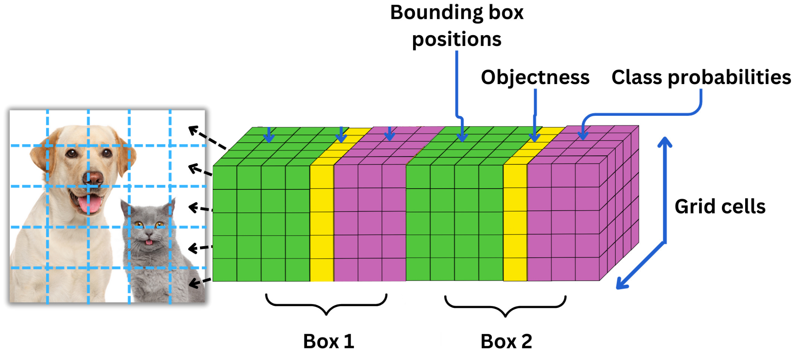
Cell Class Prediction – Amended Cell Size
S * S * ( C + 5*B ) -> S * S * (C+5) * B
Notes:
In YOLO paper each bounding box predicts one class and a number of bounding boxes
Our implementation predicts a class for each bounding box
Size of model is now equal to SxS (number of cells) * B * (C+5)
C is number of classes
B is number of bounding boxes

Slide 9
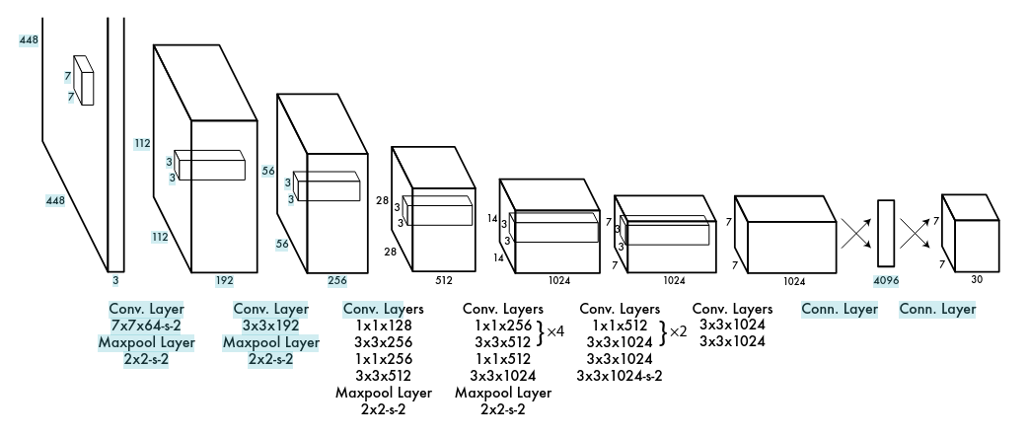
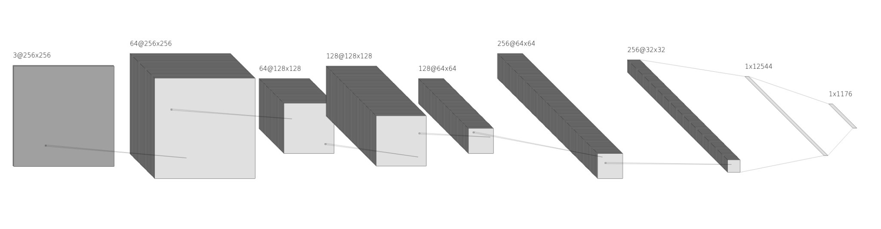
Network Size
Notes:
YOLO is a lot bigger: 24 convolutional layers and 4 pooling layers
Ours may look similarly sized, but it only has 3 convolutional and 3 pooling layers
Largely due to hardware limitations

Slide 10
Training
2,000 - 5,259 images from Hard Hat Workers Dataset
10-50 epochs
Each trial took 1-10 hours
Learning rate warm up
Confidence/IoU threshold warm up
Learning rate scheduler
Notes:
Train using Roboflow Hard Hat Dataset
Tested with minimum of 2000 images and up to 5259 images, which is the full dataset
Most training done with 10 epochs and only some are tested with 20 and 50 epochs
This is mainly because depending on number of epochs, it can take anywhere from 1 to 10 hours for each test
Techniques we have learned and implemented includes
Learning rate warmup
Confidence and IOU threshold warm up
Learning rate scheduler
Both warm ups are targeted for early epochs, and is to help model learn as much as possible regardless of accuracy in the beginning
As learning continues to later epochs, we have learning rate scheduler to slowly reduce the learning rate to avoid overshooting

Slide 11
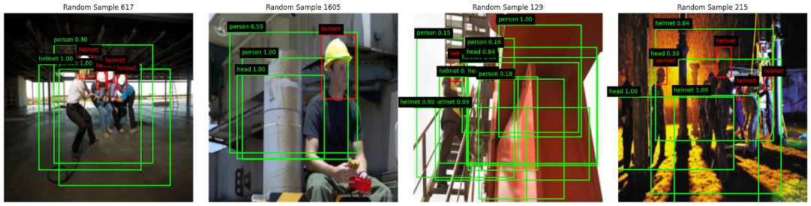
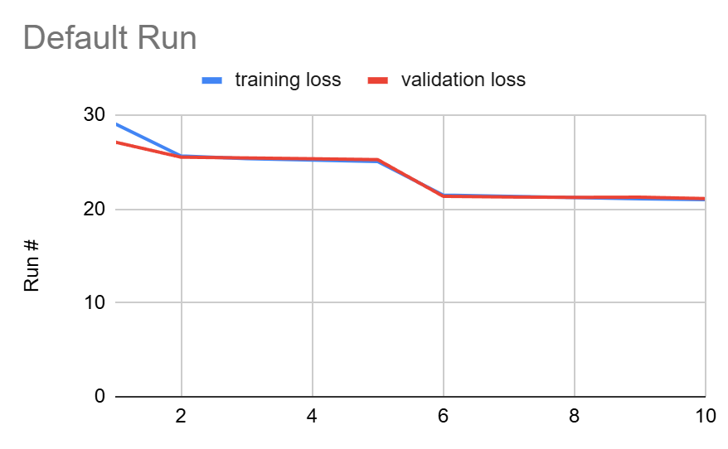
Default Run / Baseline
Notes:
The first fully working run
See significant learning on first and fifth epoch due to the learning rate, IOU and threshold warm up
After warm up ends at epoch 5, learning became stale
Does attempt to predict objects with high noise and often incorrect predictions

Slide 12
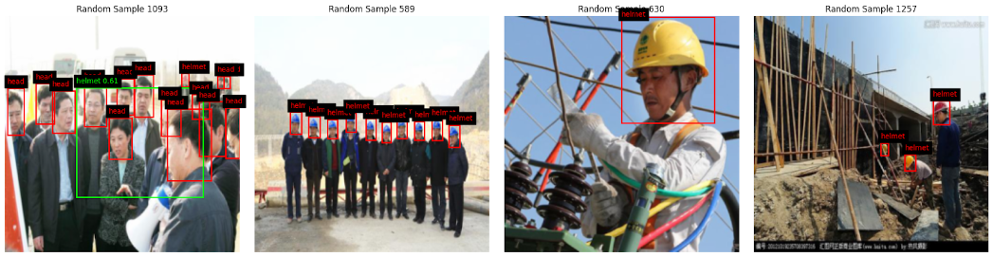
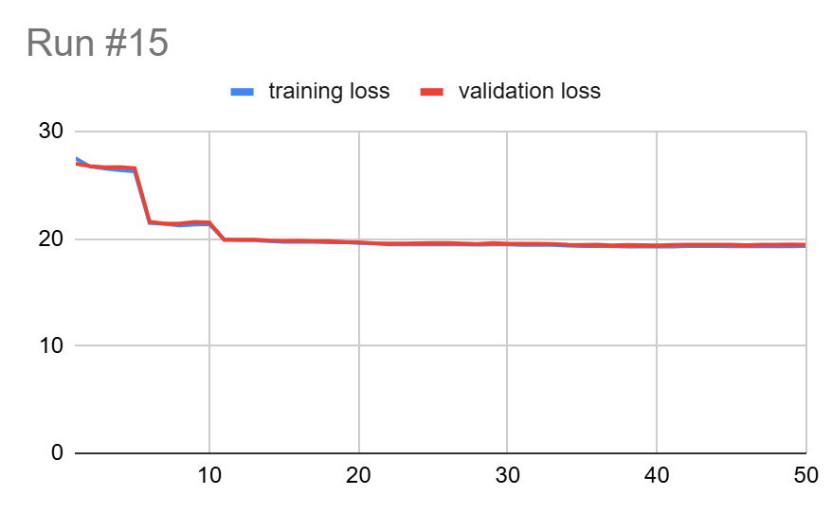
Run #15
Notes:
Tested with various parameters adjusted (lambda constants, learning rate, etc)
Tested with significantly larger data set and more epochs
Ran with all 5259 datasets and 50 epochs
Training and validation loss still not improving aside from epoch 5 and 10
Result of the confidence and IOU threshold warm up
The output is less noisy but not confident
Most likely due to the high confidence threshold

Slide 13
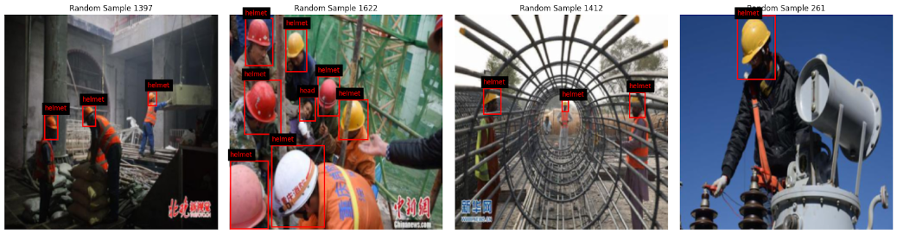
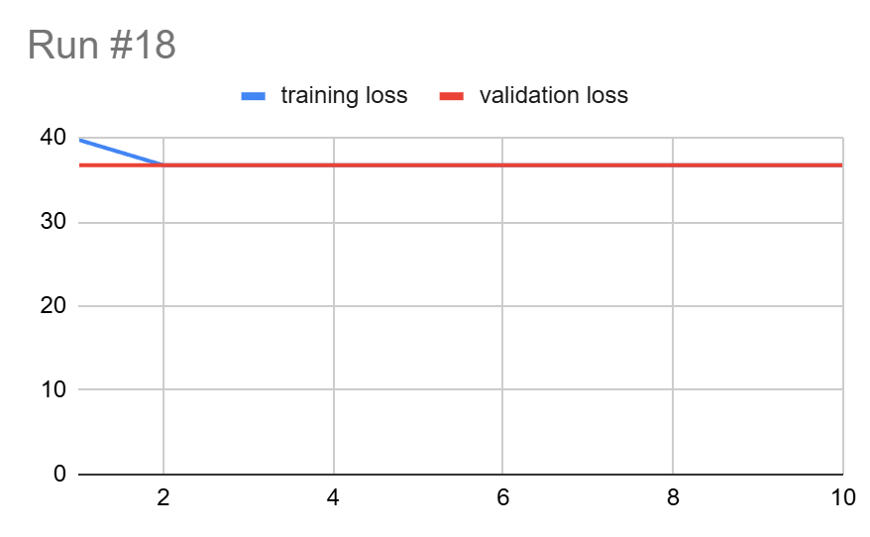
Run #18
Notes:
Knowing that the only learning we see came from the warmup and learning rate scheduler
Test run 18 without any wramup and learning rate scheduler
Still see no improvement on training and validation loss
Output with no prediction at all
Further shows that the model is not learning

Slide 14
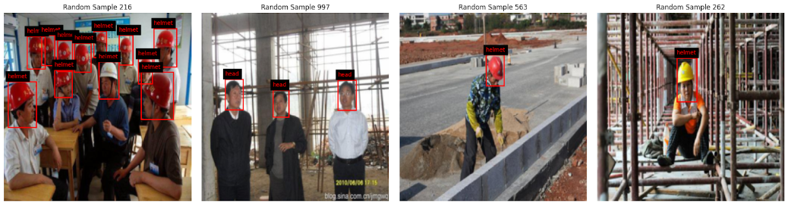
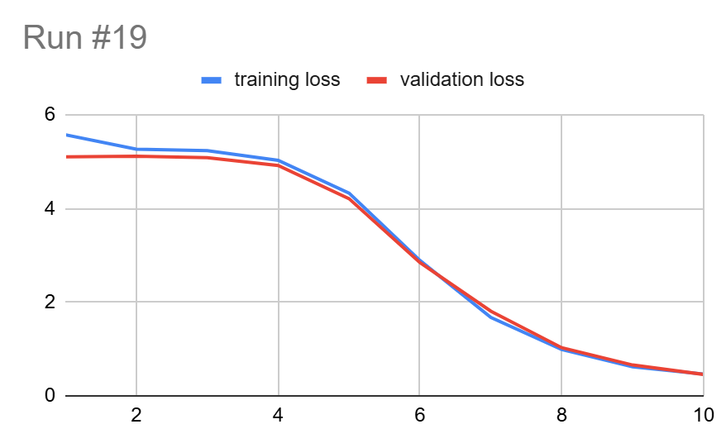
Run #19
Notes:
More testing and printing out loss function results
The reason for stale learning is caused by no object lambda
No object lambda was too high
Dominated the total loss
Healthier training and validation loss curve
Shows the model is finally learning slowly
The output still fails to predict object

Slide 15
Conclusion
Identified the cause for stale training and validation loss
Loss function and lambda constants are extremely important
Notes:
Run out of time for test
Loss function is extremely important
Single lambda constant can make and break a model

Slide 16
Future Work
More model tuning
Leverage existing model or pretrain part of model
Better hardware
Larger network
Higher resolution images
More training
Notes:
Couple work and improvements for the future
Continue to tune the loss function lambda constants
Implement some pre-trained model to help us improve the accuracy on our prediction
Opportunity to train on a better hardware
Larger datasets
Higher resolution image
Help the model learning more about the features of the object
Running more epochs
Allow model to make smaller and more adjustments to improve accuracy

Slide 17
Resources
Repo https://github.com/yyang31/CSCI611_Summer25_Final_Project
All run results: https://docs.google.com/spreadsheets/d/1tLdOCVmk66PDNjnhk-Kcpp3BZP11XCFAz4xebq8Ma9k/edit?gid=0#gid=0
YOLO paper: https://arxiv.org/abs/1506.02640
Roboflow Hard Hat Dataset https://public.roboflow.com/object-detection/hard-hat-workers
https://medium.com/@whyamit404/how-to-implement-a-yolo-object-detector-from-scratch-in-pytorch-e310829d92e6
https://medium.com/analytics-vidhya/yolo-explained-5b6f4564f31
https://www.v7labs.com/blog/yolo-object-detection
https://www.geeksforgeeks.org/computer-vision/yolov3-from-scratch-using-pytorch/
https://newsletter.theaiedge.io/p/deep-dive-how-yolo-works-part-1-from

